Slide 1
Deriving Use Cases from System Requirements
Initiator | Initiator’s Goal | Participants | Use Case Name
Tenant | Unlock and enter home. | Lock, Household Devices, Database, Mobile Phones | Unlock (UC‑1)
Landlord | Retire an existing user account and disable access. | Database | RetireUser (UC‑4)
Initiating actors (“users”) are already identified in user stories
Participating actors identified as part of use case analysis

Slide 2

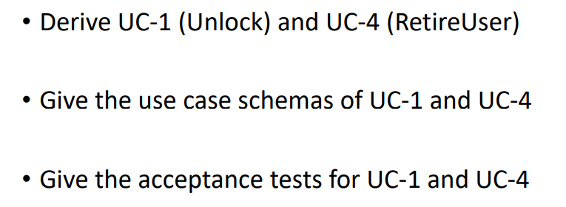

Slide 3
Use Case 1: Unlock
Use Case UC-1: |  |  | Unlock
Related Requirem’ts: |  |  | REQ1, REQ2, REQ3 and REQ4
Initiating Actor: |  |  | Any of: Tenant, Landlord
Actor’s Goal: |  |  | To disarm the lock and enter, and get space lighted up automatically.
Participating Actors: |  |  | LockDevice, LightSwitch, Timer, Database and Mobile Phone
Preconditions: |  |  | • The set of valid Bluetooth Mac Addresses stored in the system database is non-empty. The sensor on the LockDevice is always active.
Postconditions: |  |  | The auto-lock timer has started countdown from autoLockInterval.
Flow of Events for Main Success Scenario:
→ | 1. | Tenant/Landlord arrives at the door and puts Mobile Phone with Bluetooth close to the LockDevice
 | 2. | include::AuthenticateUser (UC-7)
← | 3. | System (a) signals to the Tenant/Landlord the lock status, e.g., “disarmed,” (b) signals to LockDevice to disarm the lock, and (c) signals to LightSwitch to turn the light on
← | 4. | System signals to the Timer to start the auto-lock timer countdown
→ | 5. | Tenant/Landlord opens the door, enters the home [and shuts the door and locks]

Slide 4
Use Case 1: Unlock
Use Case UC-1: |  |  | Unlock
Flow of Events for Extensions (Alternate Scenarios):
→ | 1. | The LockDevice allows the tenant/landlord try again when the pairing go wrong (e.g., the MAC address not found in the database)
 | 2. | When maximum pairing attempts are reached(e.g., fail three times) the LockDevice will notify the landlord.

Slide 5
Use Case 4: RetireUser
Use Case UC-4: |  |  | RetireUser
Related Requirem’ts: |  |  | REQ7
Initiating Actor: |  |  | Landlord
Actor’s Goal: |  |  | Retire an existing tenant account and disable access.
Participating Actors: |  |  | Database
Preconditions: |  |  | • The set of valid tenant accounts stored in the system database is non-empty. Each tenant account has additional information like his/her Mobile Phone number.
Postconditions: |  |  | The account of the tenant is removed from database.
Flow of Events for Main Success Scenario:
→ | 1. | Landlord makes a query for a tenant account in the database.
 | 2. | Landlord delete the target tenant's account.

Slide 6
Acceptance Test Case for UC-1 Unlock
Test-case Identifier: | TC-1
Use Case Tested: | UC-1, main success scenario and alternate scenario
Pass/fail Criteria: | The test passes if the user put the Mobile Phone whose Bluetooth Mac address is in the database, with less than a maximum allowed number of unsuccessful attempts
Input Data: | Bluetooth MAC address
Test Procedure: |  | Expected Result:
Step 1. Put a Mobile Phone whose Mac address is not in the database. |  | System beeps to indicate failure; records unsuccessful attempt in the database; reminds the user to try again
Step 2. Put a Mobile Phone whose Mac address is in the database. |  | System flashes a green light to indicate success; records successful access in the database; disarms the lock device

Slide 7
Acceptance Test Case for UC-1 Unlock
Test-case Identifier: | TC-2
Use Case Tested: | UC-1, main success scenario and alternate scenario
Pass/fail Criteria: | The test passes if the maximum attempts is reached, the landlord will be noticed.
Input Data: | Bluetooth MAC address
Test Procedure: |  | Expected Result:
Step 1. Put a Mobile Phone whose Mac address is not in the database before reaching the maximum attempts. |  | System beeps to indicate failure; records unsuccessful attempt in the database; reminds the user to try again
Step 2. Put a Mobile Phone whose Mac address is not in the database again. |  | System beeps to indicate failure; records unsuccessful attempt in the database; sends message to the landlord. The sensor shuts down.

Slide 8
Acceptance Test Case for UC-4 RetireUser
Test-case Identifier: | TC-3
Use Case Tested: | UC-4, main success scenario
Pass/fail Criteria: | The test passes if the landlord retrieves the target tenant account and delete it
Input Data: | The key word for the target tenant
Test Procedure: |  | Expected Result:
Step 1. Make a query for the target tenant. |  | Database returns the tenant’s account information including the phone number.
Step 2. Delete the target tenant in the database. |  | Database removes the tenant’s account including the Bluetooth MAC address.
Step 3. Put the removed tenant’s Mobile Phone. |  | System beeps to indicate failure; records unsuccessful attempt in the database; reminds the user to try again.

